Slide 1

MEDICAL VISUAL QUESTION ANSWERING
SWATHY T E
Reg. No: MG24C7115007
External Guide: ANSUMAN MAHAPATRA
Internal Guide: JIBY JOSEPH
Data Science and Analytics
School of Data Analytics
Mahatma Gandhi University, Kottayam
2026

Slide 2



INTRODUCTION
Medical Visual Question Answering (Med-VQA) combines computer vision and NLP to answer clinical questions about medical images.
Radiological imaging volumes are growing rapidly, while trained radiologists remain in short supply worldwide.
General-purpose vision-language models lack specialized medical knowledge and reasoning ability.
Goal: Fine-tune Google's MedGemma-4B-IT model using LoRA on the RadImageNet-VQA dataset to build an accurate, reasoning-capable radiology VQA system.
Radiology Images
X-ray, CT, MRI
Vision-Language Model
MedGemma-4B-IT
Reasoned Answers
Clinically grounded
2

Slide 3

PROBLEM STATEMENT & OBJECTIVES
Objectives
Problem Statement
1
Build a reasoning-augmented Med-VQA dataset from RadImageNet-VQA.
Scarcity of large-scale, high-quality medical VQA datasets across imaging modalities.
Most models give short answers with no clinical reasoning, limiting clinical trust.
Domain shift between general VLMs and radiology image semantics.
Need for computationally feasible, domain-specific fine-tuning strategies.
2
Fine-tune MedGemma-4B-IT using LoRA for parameter-efficient adaptation.
3
Validate the model on held-out data (loss, perplexity, accuracy).
4
Evaluate base vs fine-tuned model with ROUGE, BLEU, EM and F1.
5
Analyze quantitative and qualitative improvements from fine-tuning.
3

Slide 4
LITERATURE REVIEW
[1]
Antol et al. (2015) introduced the original VQA task and benchmark for free-form question answering over images.
[2]
Lau et al. (2018) introduced VQA-RAD, the first manually curated radiology VQA dataset.
[3]
Ben Abacha et al. (2019) proposed ImageCLEF VQA-Med with category-aware question routing.
[4]
Li et al. (2023) developed LLaVA-Med via instruction-tuning on biomedical figure-caption pairs.
[5]
Zhang et al. (2023) introduced BioMedCLIP, trained on 15M biomedical image-text pairs.
[6]
Hu et al. (2022) introduced LoRA - low-rank adaptation for efficient LLM fine-tuning, used in this project.
[7]
Google DeepMind (2024) released MedGemma - a medically pre-trained vision-language model family.
Key insight: Domain-specific fine-tuning with LoRA [6] on reasoning-augmented data substantially improves Med-VQA performance over zero-shot baselines.
4

Slide 5
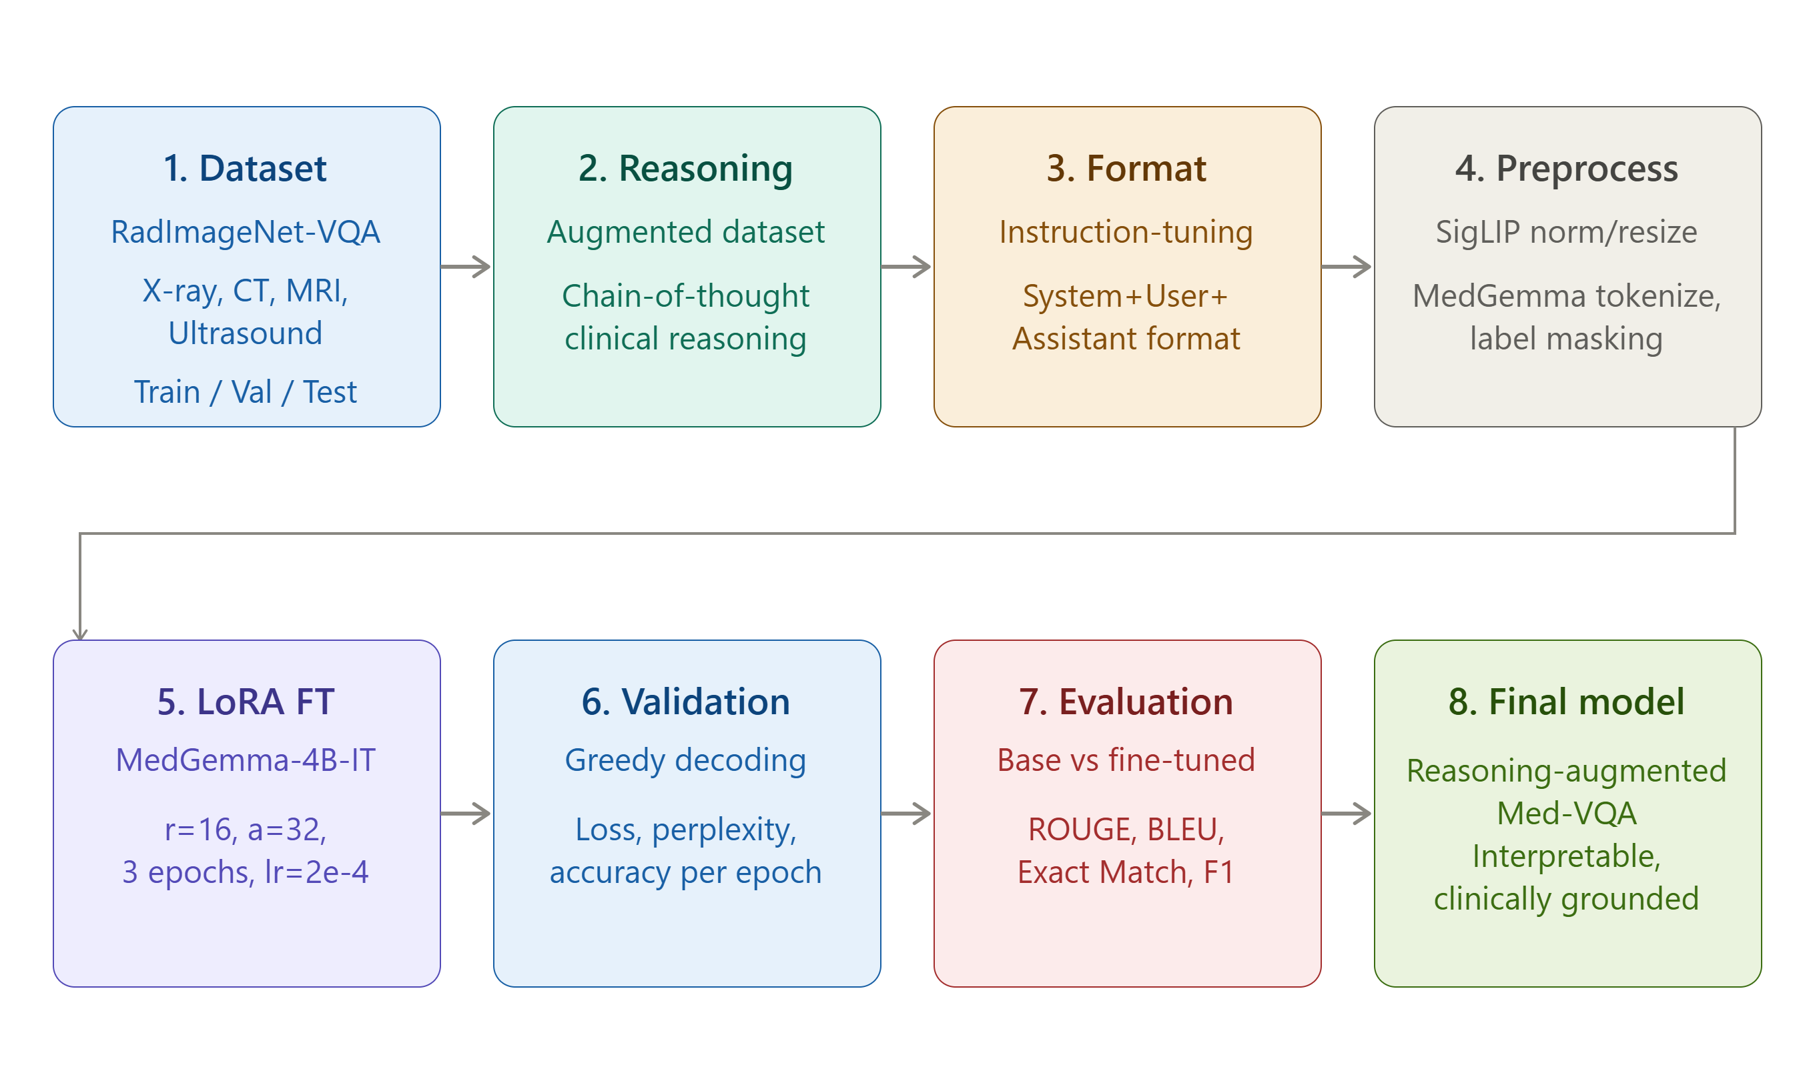
METHODOLOGY: FULL PIPELINE
5

Slide 6
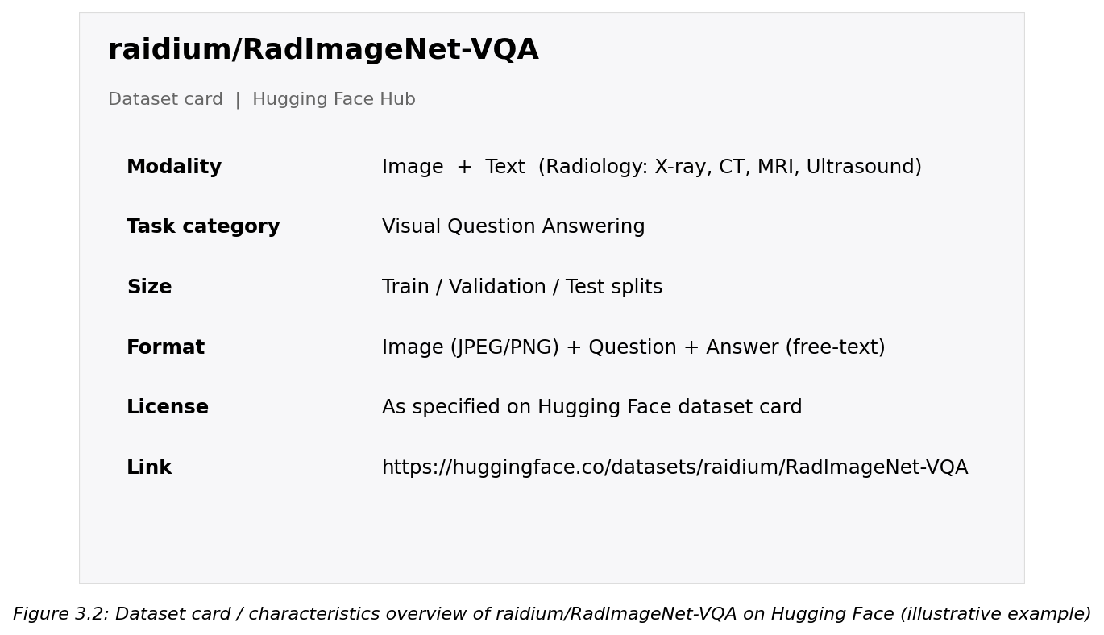


DATASET: RadImageNet-VQA
Dataset Characteristics
Source
raidium/RadImageNet-VQA (Hugging Face)
Modalities
X-ray, CT, MRI, Ultrasound
Question Types
Open-ended, Closed-ended, Descriptive
Answer Format
Free-text natural language
Splits
Train / Validation / Test
Domain
Radiology & Medical Imaging
https://huggingface.co/datasets/raidium/RadImageNet-VQA
6

Slide 7


MODEL ARCHITECTURE: MedGemma-4B-IT
google/medgemma-4b-it - a 4B parameter multimodal instruction-tuned model from Google's Gemma 3 family, pre-trained on diverse medical imaging data.
Medical Image
SigLIP Vision Encoder
Gemma-3 Language Backbone
Generated Answer
X-ray / CT / MRI input
Visual feature extraction
Grouped-query attention + RoPE
Reasoning + final answer
Vision encoder converts medical images into visual tokens grounded in medical pre-training.
Visual tokens are combined with the user's question and passed to the Gemma-3 Language Backbone.
Medical pre-training gives MedGemma a strong starting point for radiology-specific fine-tuning.
7

Slide 8
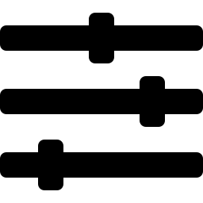
LoRA FINE-TUNING STRATEGY
LoRA Configuration
Low-Rank Adaptation (LoRA)
LoRA Rank (r)
16
Instead of updating all 4B parameters, LoRA injects small trainable low-rank matrices A and B into selected layers:
ΔW = B × A
Only A and B are trained; the original weight matrix W stays frozen.
LoRA Alpha
32
LoRA Dropout
0.05
Target Modules
q,k,v,o_proj, gate,up,down_proj
Base Precision
bfloat16 (no quantization)
Base model loaded in bfloat16 - NO quantization applied
LoRA adapters injected into attention
Only ~42M of ~4B parameters (~1%) are trainable
Trainable Params
~42M (~1% of 4B)
8

Slide 9
TRAINING CONFIGURATION & PROCESS
3
8 steps
Epochs
bf16
Grad. Accumulation
Mixed Precision
8
2e-4
adamw_torch
Effective Batch Size
Learning Rate
Optimizer
SFTTrainer (TRL) performs supervised fine-tuning: cross-entropy loss computed only on answer tokens (prompt tokens masked), with LoRA gradients updated via gradient-accumulated backward passes.
9

Slide 10
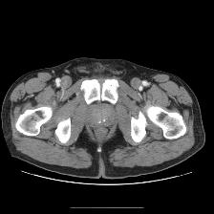
SAMPLE MODEL OUTPUTS
Example CT scan (abdomen) used as the input image for the sample VQA queries in this section.
10

Slide 11
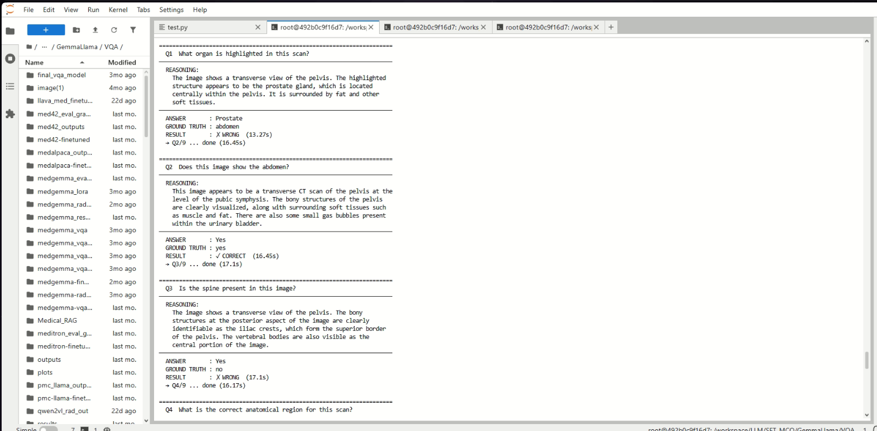
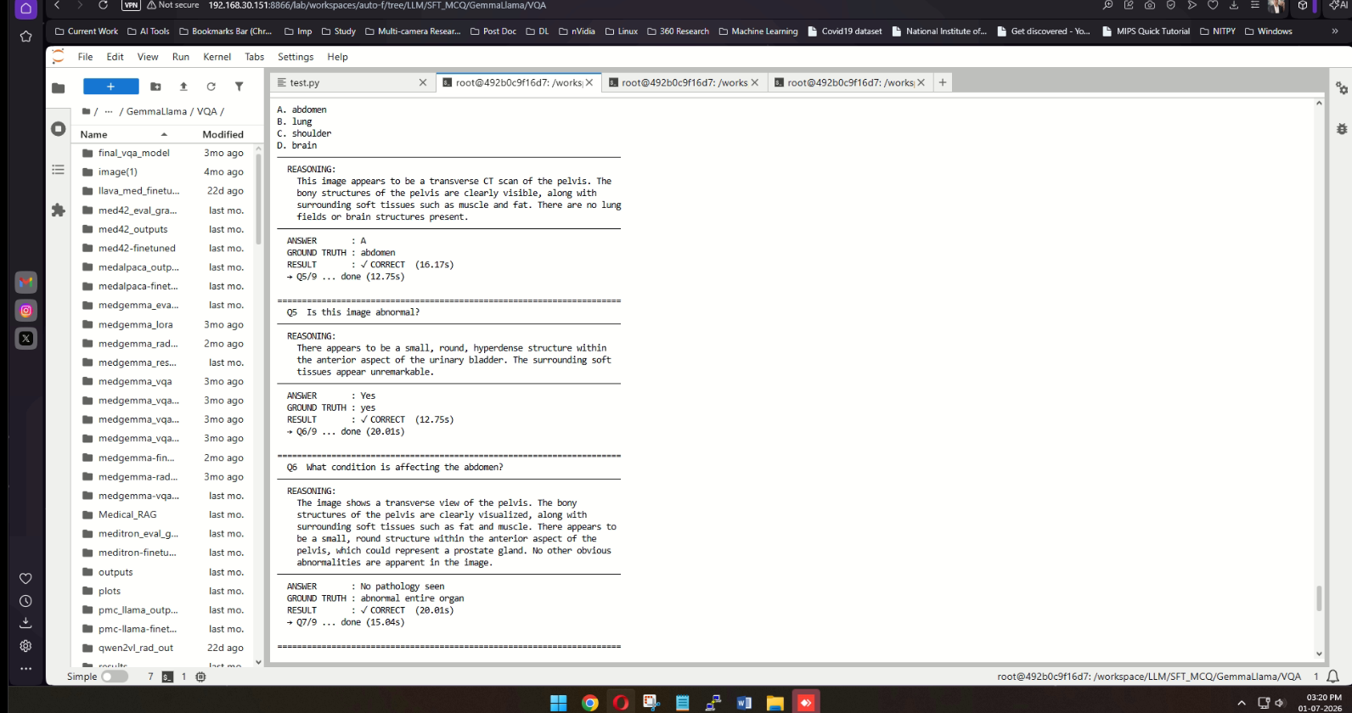
Model reasoning and predictions for Questions 1–3
Model reasoning and predictions for Questions 4–6
11

Slide 12
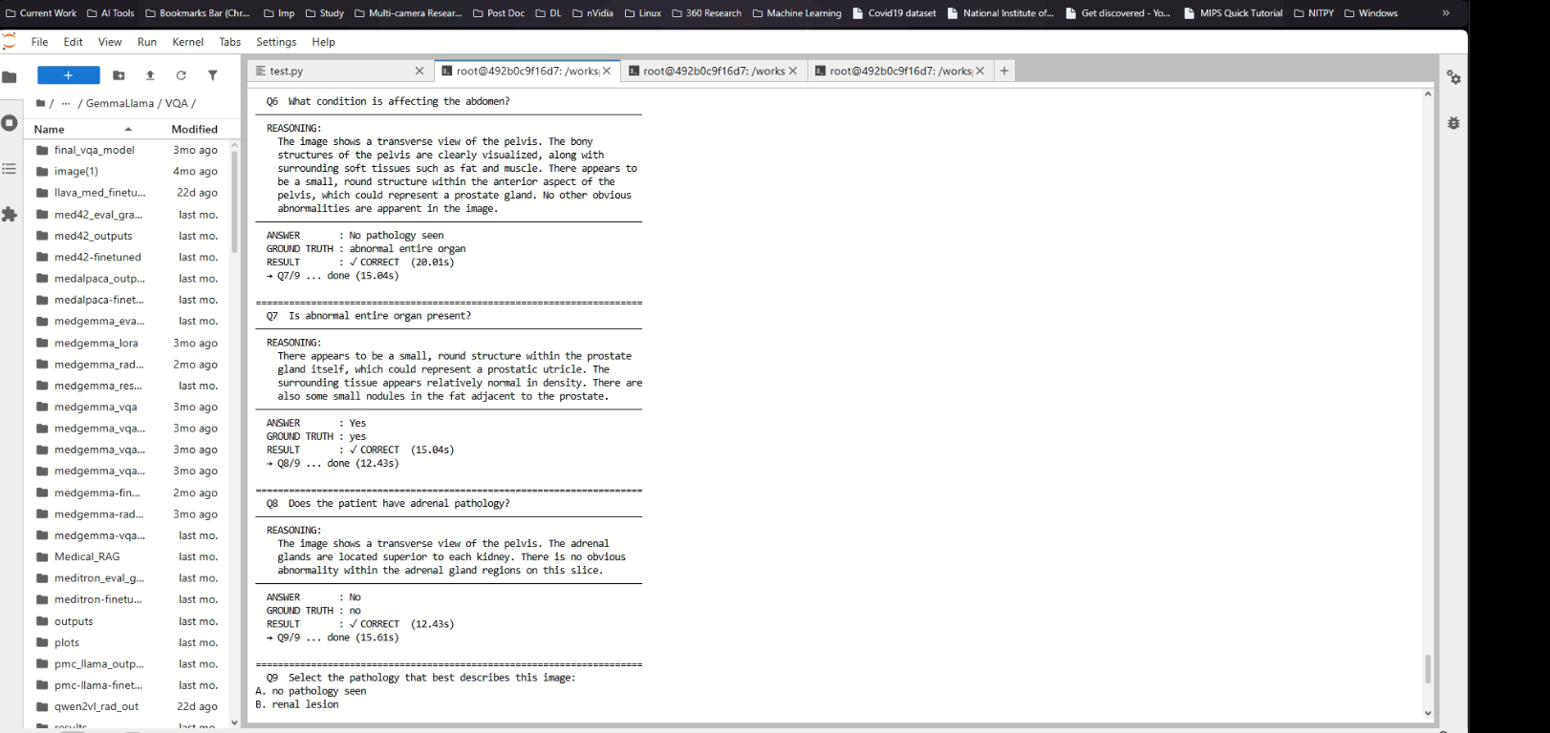
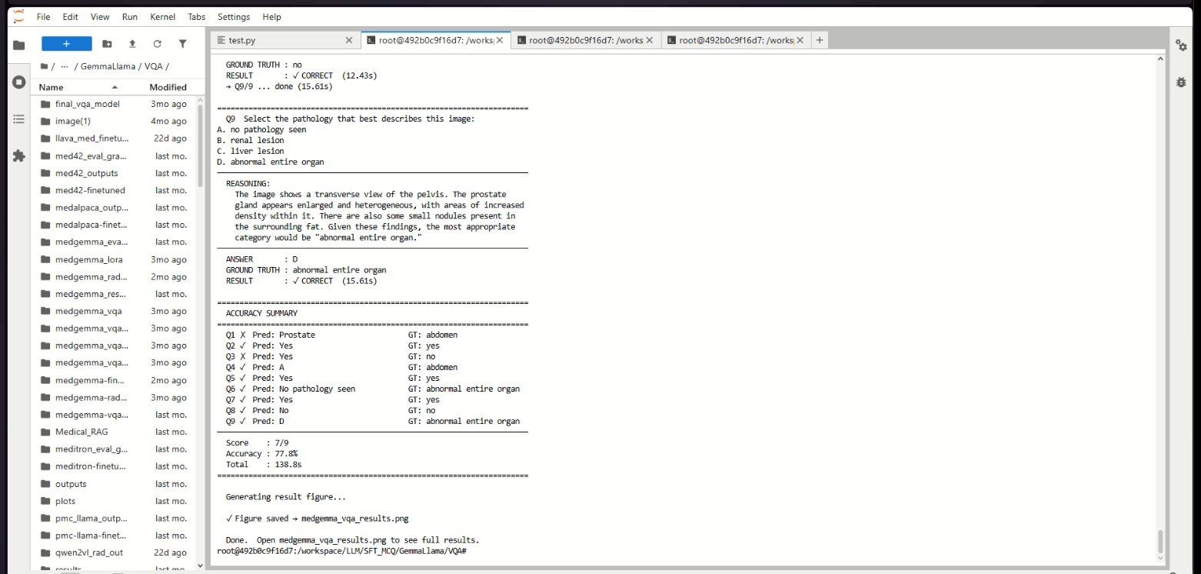
Model reasoning and predictions for Questions 6–9
Question 9 reasoning and final accuracy summary (7/9 correct, 77.8%)
12

Slide 13
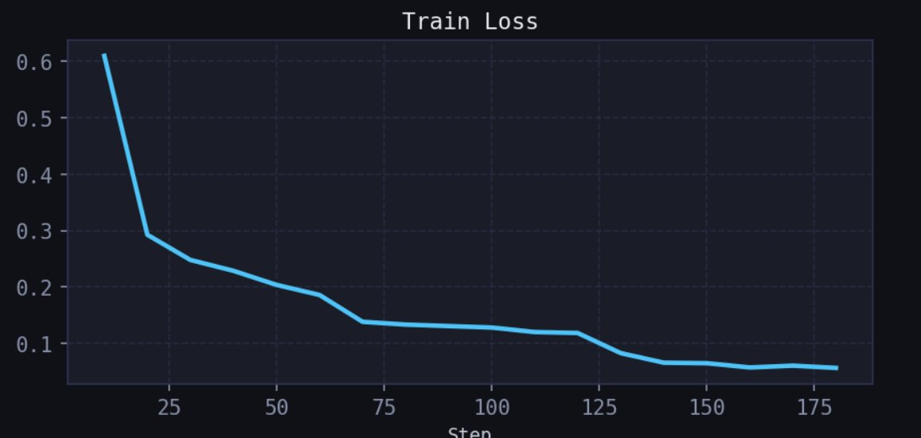
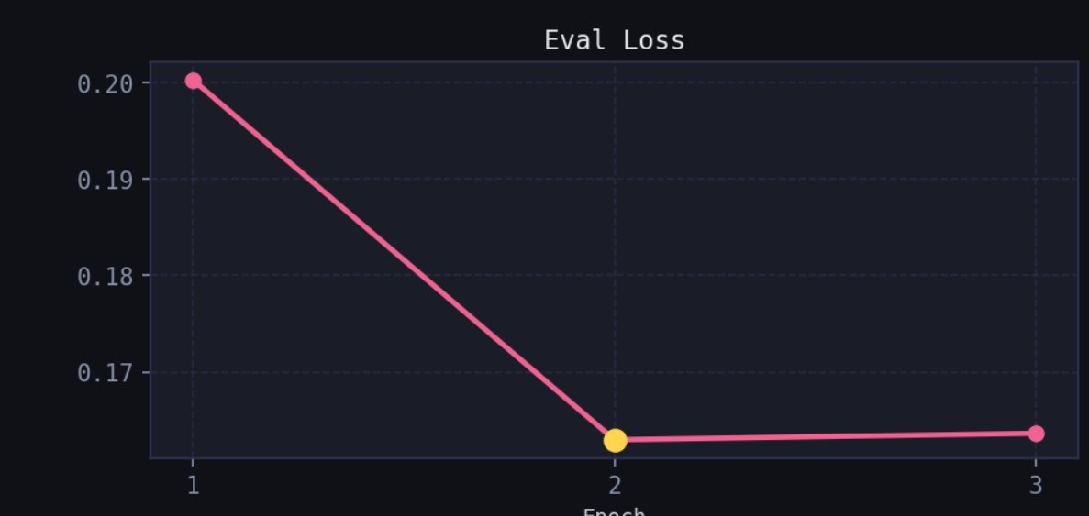
MODEL VALIDATION: TRAINING & EVAL LOSS
Figure 4.1: Training Loss
Figure 4.2: Evaluation Loss
Loss falls from ~0.61 to ~0.05-0.06 by step ~180, showing rapid LoRA convergence.
Validation loss drops from ~0.201 (epoch 1) to ~0.163 (epoch 2-3), confirming good generalization, no overfitting.
13

Slide 14
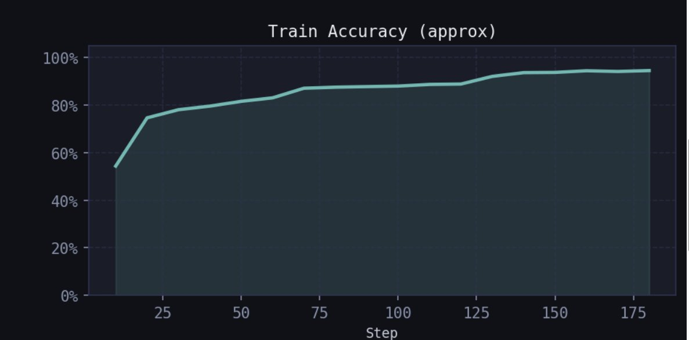
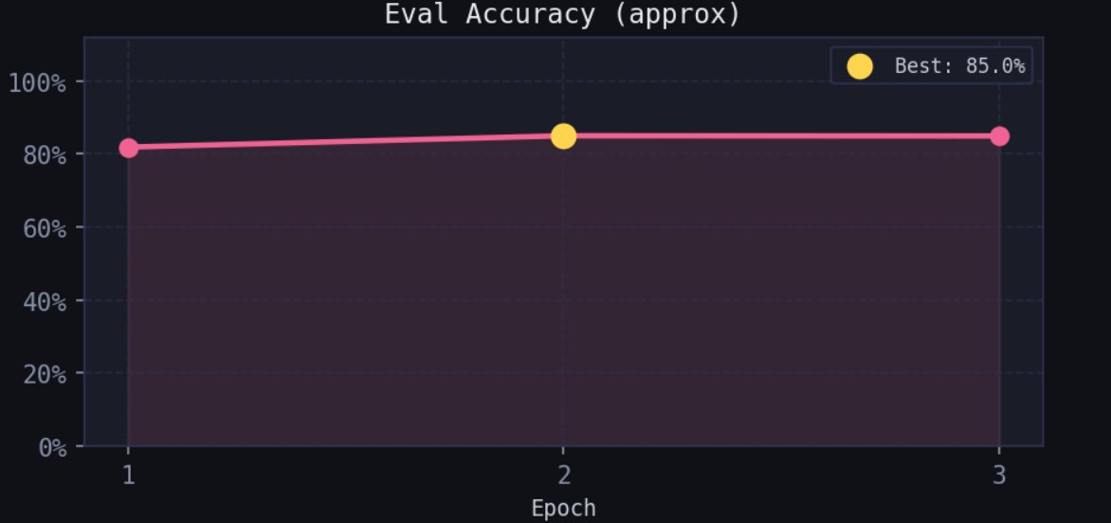
MODEL VALIDATION: TRAINING & EVAL ACCURACY
Figure 4.3: Training Accuracy
Figure 4.4: Evaluation Accuracy
Rises from ~54% to a plateau of ~94-95% by the end of training (step ~180).
Improves from ~81% (epoch 1) to a best of 85% (epoch 2), sustained at epoch 3.
Figures 4.1-4.4 together confirm stable convergence with no overfitting across all 3 training epochs.
14

Slide 15
EVALUATION: BASE vs FINE-TUNED MODEL
Evaluation Summary (selected metrics)
Metric
Base
Fine-tuned
Δ
reasoning_rouge1
0.498
0.648
+0.150
reasoning_bleu4
0.195
0.427
+0.231
answer_rouge1
0.347
0.980
+0.633
answer_bleu4
0.063
0.251
+0.188
answer_exact_match
0.240
0.980
+0.740
answer_f1
0.320
0.980
+0.660
No external comparison models were used. Evaluation is strictly Base (pre-trained) vs Fine-tuned (LoRA) MedGemma-4B-IT on the RadImageNet-VQA test set.
15

Slide 16
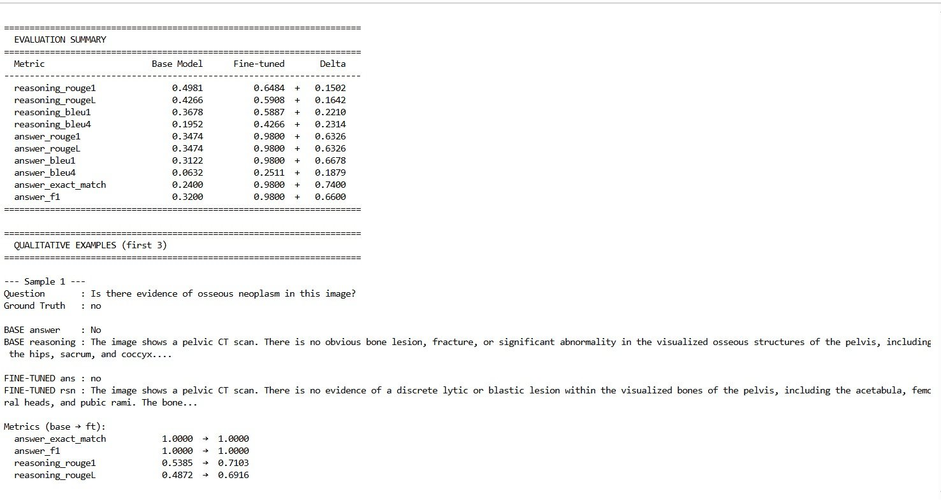
PERFORMANCE ANALYSIS
Figure 4.8: Evaluation summary - Base vs Fine-tuned, with sample qualitative output.
16

Slide 17
answer_exact_match jumps from 0.24 to 0.98 (+0.74) - near-perfect answer correctness.
answer_f1 improves from 0.32 to 0.98 (+0.66).
reasoning_bleu4 improves from 0.195 to 0.427 (+0.231) - clearer clinical reasoning.
Fine-tuned model gives precise, structured findings (e.g. specific bone/lesion references) vs generic descriptions from the base model.
Gains are largest on answer-level metrics; reasoning-level metrics improve substantially but leave room for further gains.
17

Slide 18
CONCLUSION
Built a reasoning-augmented Med-VQA dataset from RadImageNet-VQA with chain-of-thought clinical explanations.
Fine-tuned MedGemma-4B-IT with LoRA using only ~42M trainable parameters (~1% of total).
Fine-tuned model achieved answer_exact_match = 0.98 and answer_f1 = 0.98, vs 0.24 / 0.32 for the base model.
Reasoning quality improved substantially (reasoning_bleu4: 0.195 → 0.427).
Training curves (Figures 4.1-4.7) confirm stable convergence with no overfitting.
LoRA-based domain adaptation is computationally feasible on a single GPU - accessible for research teams.
18

Slide 19




FUTURE WORKS
Multi-Modal Expansion
RLHF Alignment
Retrieval-Augmented Generation
PET, SPECT, histopathology & multi-institutional data
Clinician feedback via preference learning
Ground answers with clinical guideline retrieval
Clinical Integration
Hallucination Mitigation
Mobile & Multilingual
DICOM / PACS-compatible deployment
Confidence calibration & factual grounding
Lightweight point-of-care app, regional languages
19

Slide 20
REFERENCES
[1] Antol et al. (2015). VQA: Visual Question Answering. ICCV.
[2] Lau et al. (2018). A dataset of clinically generated visual questions and answers about radiology images. Scientific Data.
[3] Ben Abacha et al. (2019). VQA-Med: ImageCLEF 2019 Medical VQA Task. CLEF Working Notes.
[4] Li et al. (2023). LLaVA-Med: Training a Large Language-and-Vision Assistant for Biomedicine. NeurIPS.
[5] Zhang et al. (2023). BiomedCLIP: a multimodal biomedical foundation model. arXiv:2303.00915.
[6] Hu et al. (2022). LoRA: Low-Rank Adaptation of Large Language Models. ICLR.
[7] Google DeepMind (2024). MedGemma: Medical multimodal models from Google. Technical Report.
[8] Radford et al. (2021). Learning transferable visual models from natural language supervision (CLIP). ICML.
[9] Ziegler et al. (2019). Fine-tuning language models from human preferences. arXiv:1909.08593.
[10] Raidium (2024). RadImageNet-VQA dataset. Hugging Face Hub.
[11] Wolf et al. (2020). Transformers: State-of-the-art NLP. EMNLP System Demos.
[12] Papineni et al. (2002). BLEU: a method for automatic evaluation of machine translation. ACL.
[13] Banerjee & Lavie (2005). METEOR: An automatic metric for MT evaluation. ACL Workshop.
[14] Touvron et al. (2023). LLaMA: Open and efficient foundation language models. arXiv:2302.13971.
20

Slide 21
THANK YOU
21

